Slide 1
(Deep) Learning to Distinguish HII Regions from Galaxies
Allen Papp, Annabel To (att959@utexas.edu)
Dr. Shyamal Mitra
UT Austin Geometry of Space Research Group

Slide 2
Outline
Overview of HII regions
What are HII regions?
Why are they important?
Pipeline methodology
Results
Future directions

Slide 3
Purpose
Creating a pipeline to distinguish HII regions from galaxies
Use pipeline to create repository of HII regions
Maximize efficiency for general application/large area-processing

Slide 4
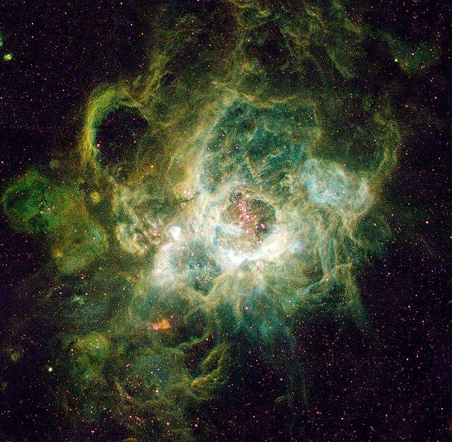
What are HII regions?
Ionized hydrogen gas clouds surrounding O or B type stars
produce forbidden line spectra (21 - 22 μm)

Slide 5
Background and Data
Datasets: images captured using WISE telescope
Galaxy coordinates from GalaxyZoo 2nd data release
HII region coordinates from Anderson et. al
uses forbidden and radio recombination lines to identify HII regions

Slide 6
Classification Pipeline: Overview
Recursive grid division
starts at 1200 arcseconds
splits image into grid
Gradient filter over brightness
per grid unit, look for appreciable gas structure
Convolutional neural net:
modified from AlexNet, fewer dense neurons/kernel params
data augmentation

Slide 7
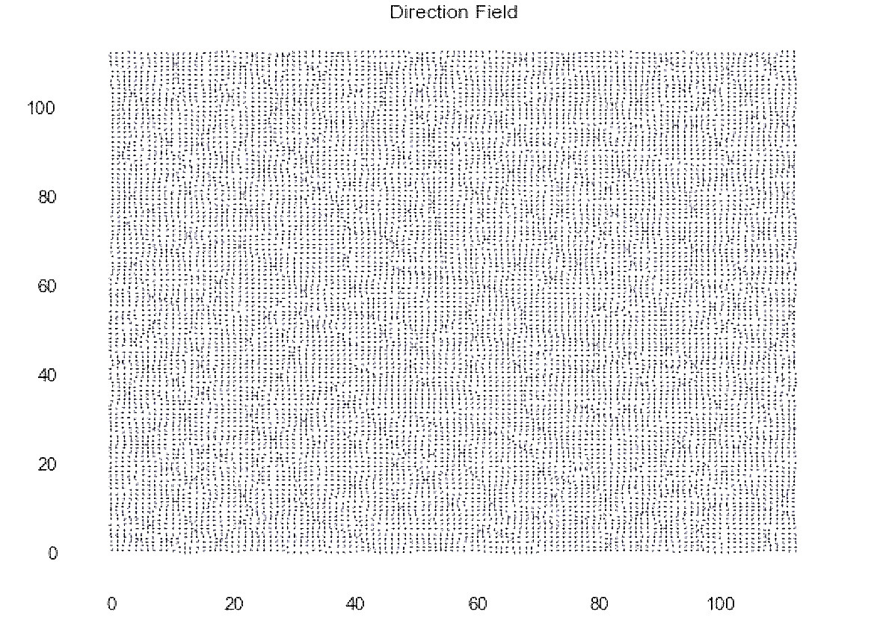
Classification Pipeline: Gradient Filter
Reduces computational load
drops ~94% random images
targets: noise, distant points (unclassifiable)
Isolates gradients of observable length (gaseous structure)
Vectors normalized
Magnitude of higher vectors thresholded → indicates potential HII region candidate

Slide 8
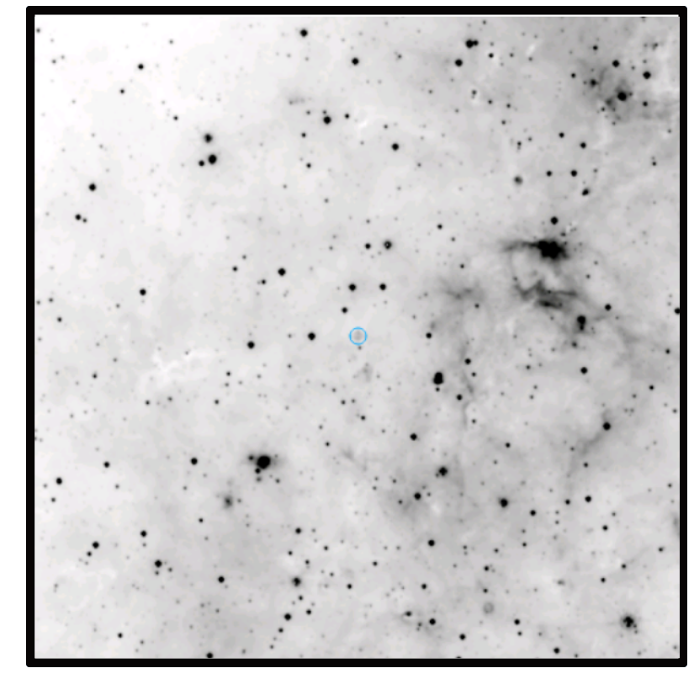
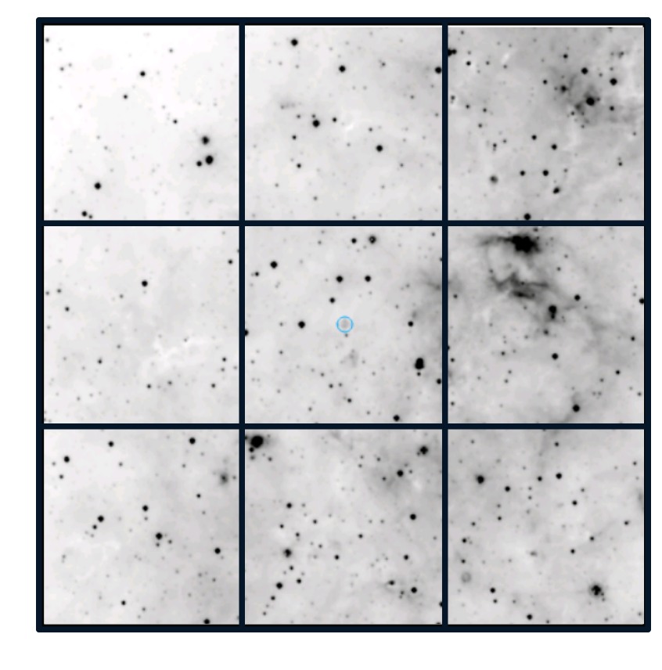
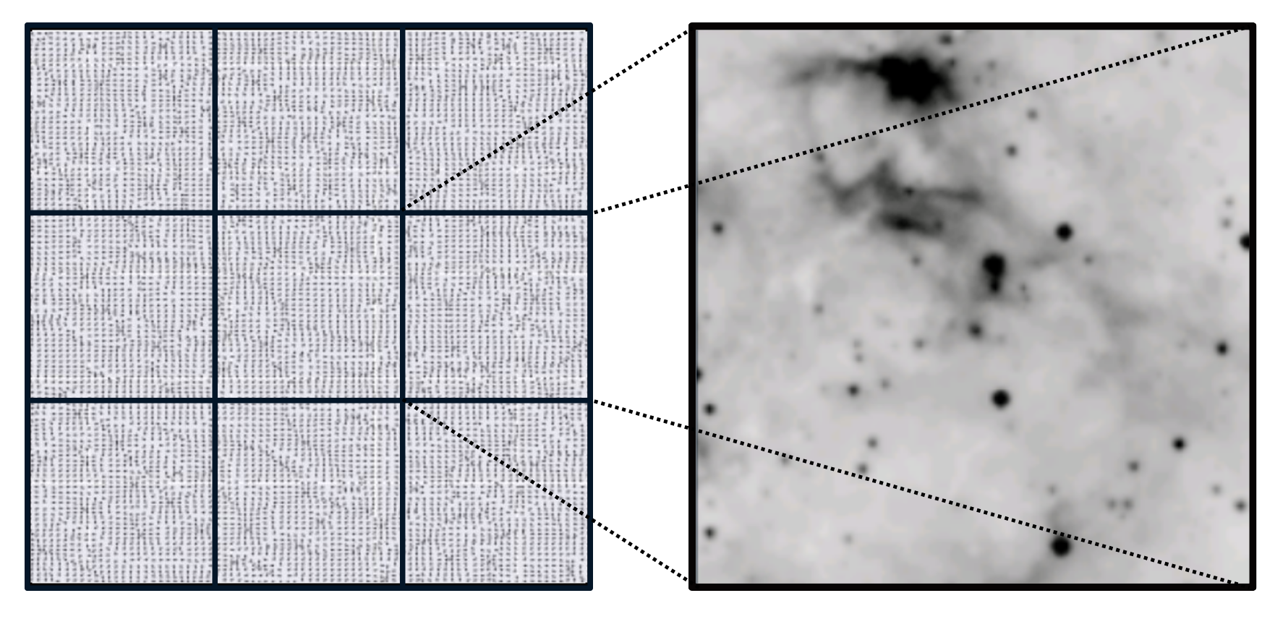
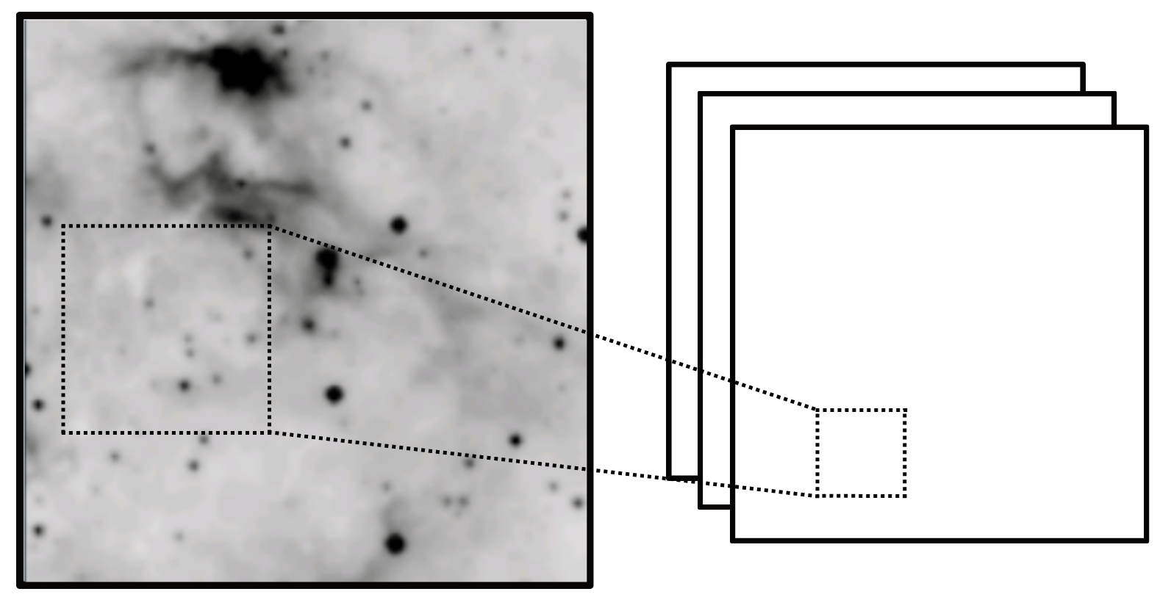
appreciable structure found?
Original image
Recursive grid division and focus using brightness gradient
CNN classification, label weighted by zoom
HII region found?
Classification Pipeline

Slide 9
Pipeline: Convolutional Neural Net (CNN)
Current architecture: segmentation, alongside 8 layers feature extraction, 2 layers fully connected, dropout + softmax
10% fewer dense-layer (classification) neurons than standard layers for similar dataset size
reduced feature extraction window to 3x3 from a 5x5
Dataset simple → less params
only single color channel (images at W3 passband)

Slide 10
CNN Architecture: Design Decisions
Smaller dense layers
preprocessing: grayscale, affine resize, normalization
max pooling interleaved with average pooling layers
Experimented w/ neural nets:
AlexNet
SegUNet
VGGNet
Mask R-CNN w/ astroNN semantic masking
Above experimentations done with full comparative testing

Slide 11
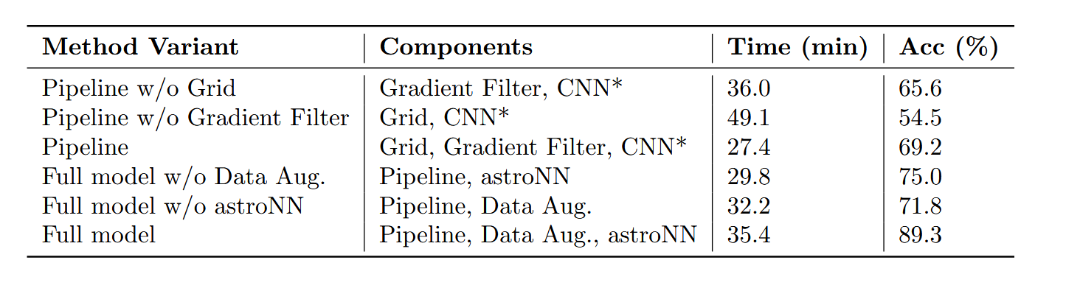
Results
Classification success 87% ∓ 5% given described model + pipeline alongside image preprocessing and data augmentation
Ablation testing
verified performance of pipeline components
affirmed data augmentation plays significant role in learning
*CNN is defined as the described model + astroNN Masking, but no Data Augmentation.

Slide 12
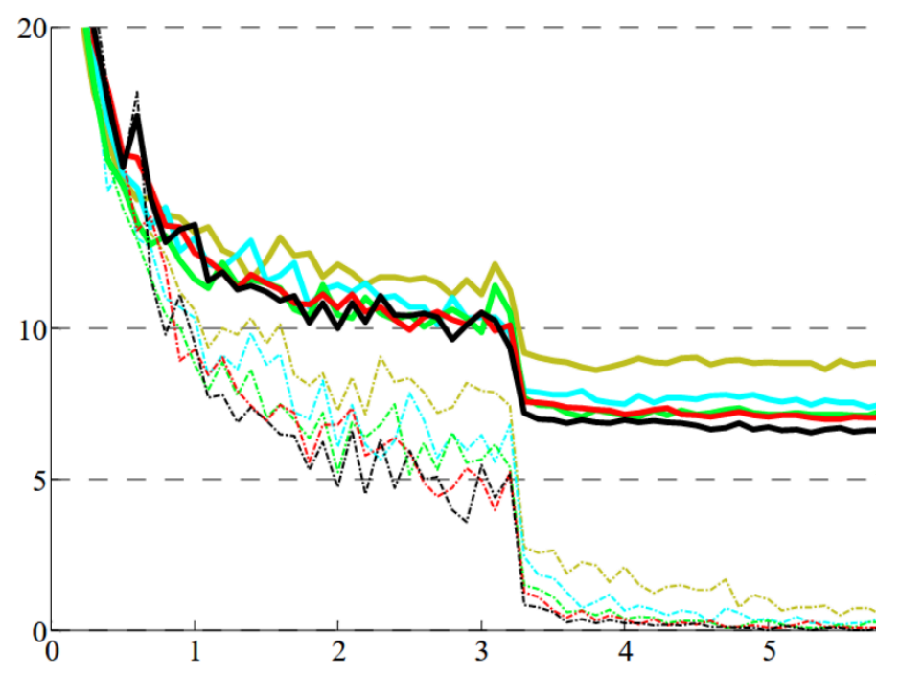
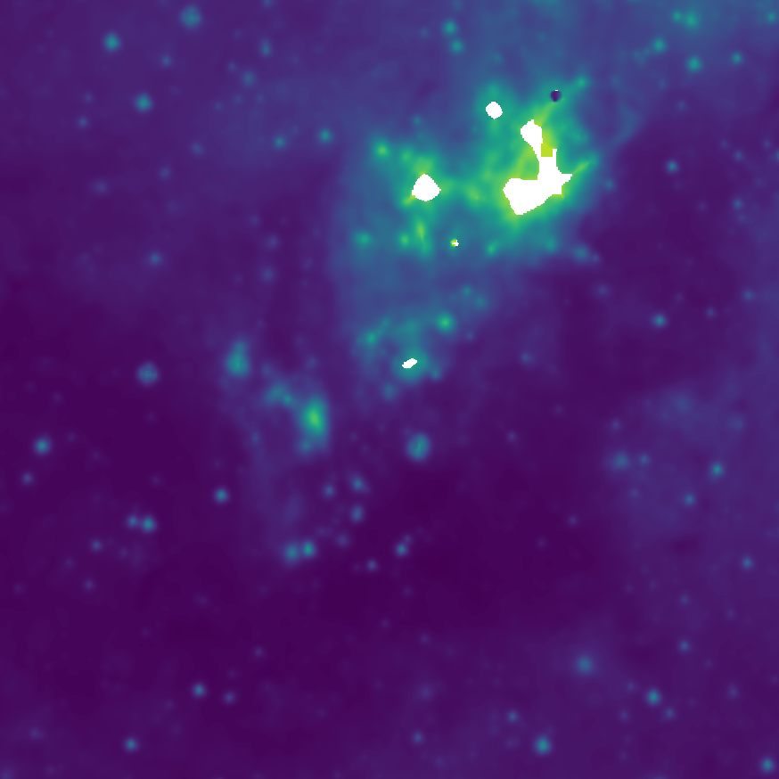
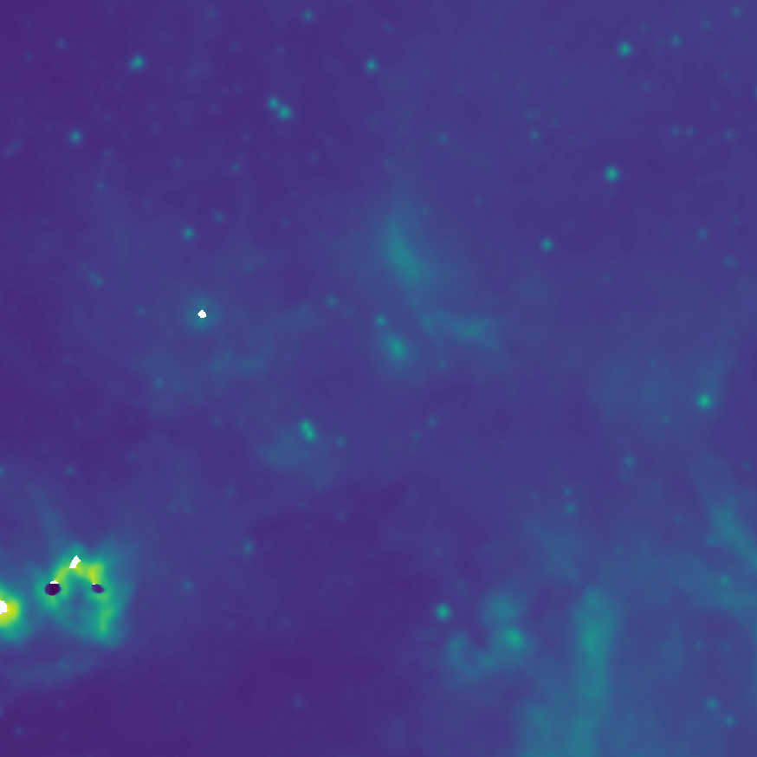
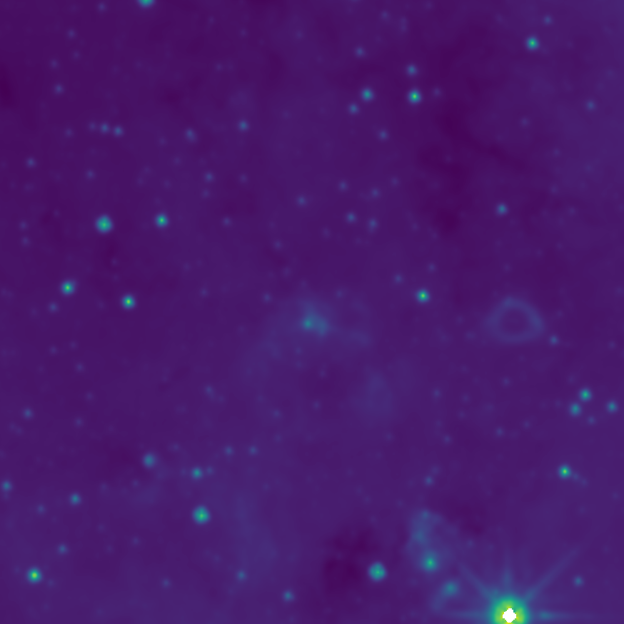
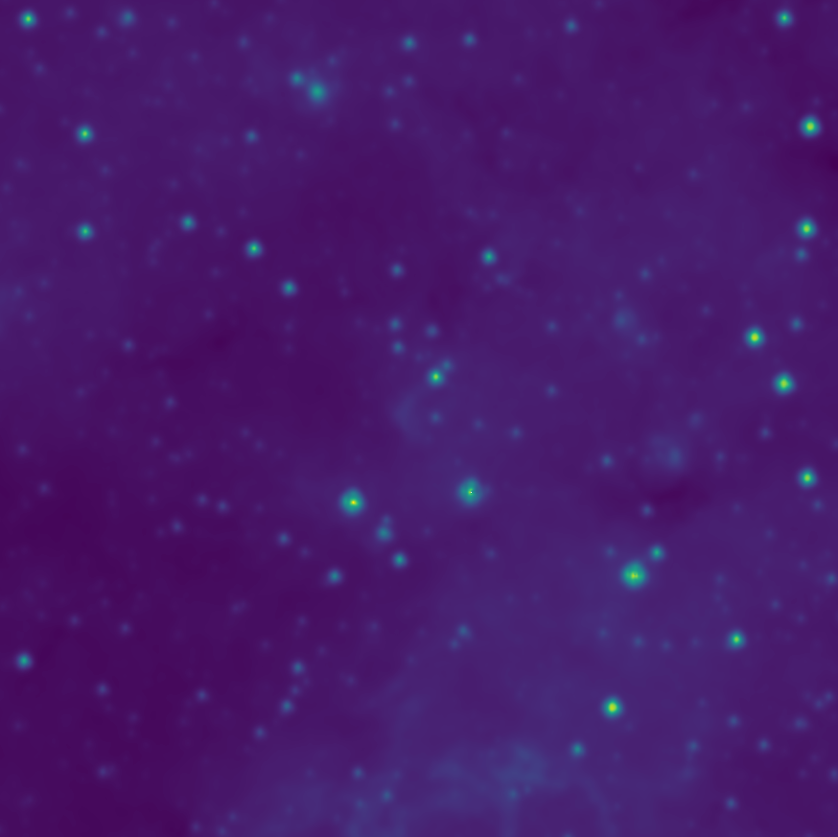
gold: AlexNet
cyan: SegUNet
green: VGGNet
red: Mask R-CNN w/
graphical masking
black: Final (Mask R-CNN w/ astroNN, pooling + dropout)
False negatives (above)
False positives (below)
Error (%)
Iteration (1e2)
(Left) Comparative model training (dotted)/testing (bold) error rates; (Right) Error example images

Slide 13
Conclusions
Significant accuracy achieved with mostly image recognition
most current models classify H II Regions with reionization region analysis
Data augmentation more effective for astronomical images (W4, re-ort)
low overhead
close features difficult to distinguish via filters
Pipelining needed for sparse images
significantly reduced computational load

Slide 14
Future Directions
Adaptation toward other image classification problems in astronomy
Nebulae
Galaxy morphology
Dataset augmentation via simulation (scaling up input)
Incorporating temporal data
Gated recurrent units in Recurrent neural networks (RNN)
Attention mechanisms (transformers)

Slide 15
Summary
Processing astronomical images efficiently requires:
data augmentation
gradient filter for noise
proper utilization of passbands
Current model achieves 87% ∓ 5% classification success with purely image (pixelwise) analysis
Onto application of pipeline to other image classification problems in astronomy

Slide 16
Acknowledgements
We express sincere gratitude for the coordinates data from the Galaxy Zoo 2nd data release and L.D. Anderson et. al, the image data from the WISE telescope through IPAC at the California Institute of Technology, and the assistance of other members of the Geometry of Space research group, namely Jose Ordonez and Rik Ghosh, as well as Dr. Karl Gebhardt and Dr. Shyamal Mitra.

Slide 17
Thanks for listening! Questions?

Slide 18
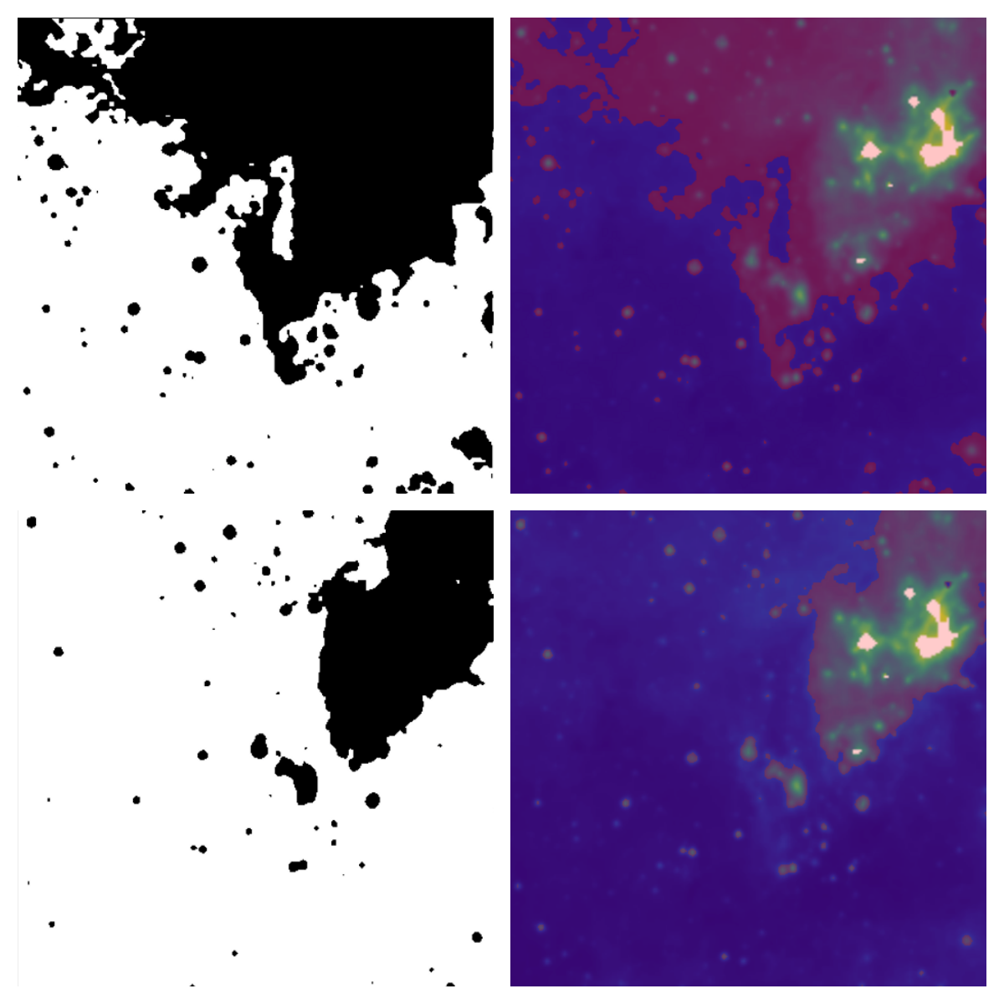
Segmentation Approach
Addresses issue of compound images (ie. overlapping nebulae and HII region within same image)
Modified from SegUNet and Mask R-CNN (+astroNN)
most success in general classification (between varied objects) with Mask-RCNN
distinguishing b/t HII and galaxy images → SegUNet

Slide 19
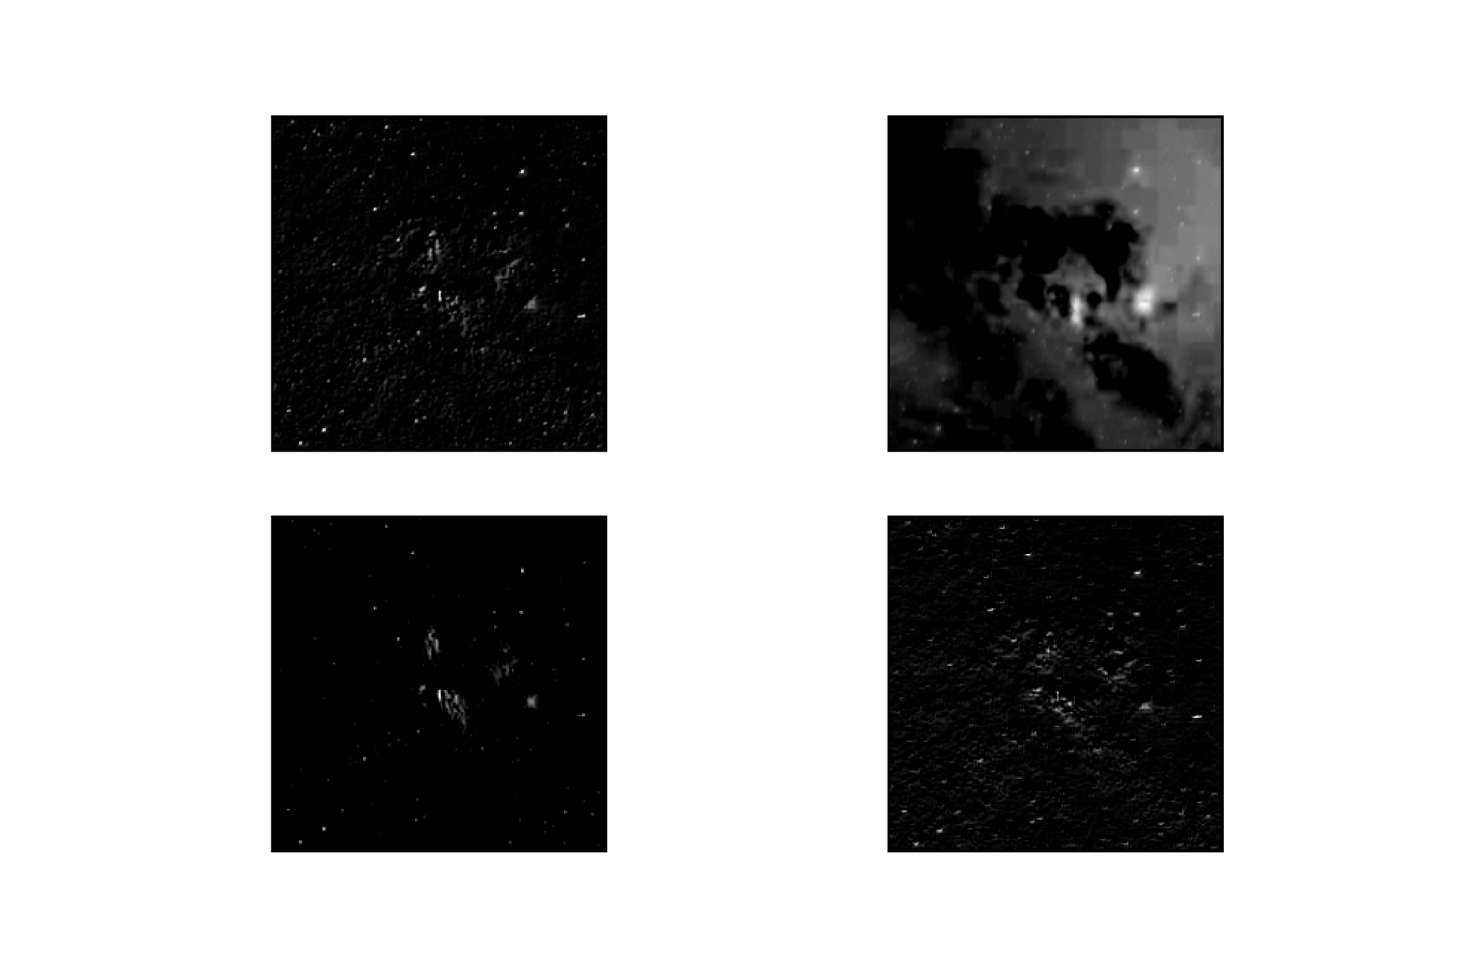
Notable features from two filters, at 2000 vs 6000 arcseconds (left) and bounded segmentation (right)

Slide 20
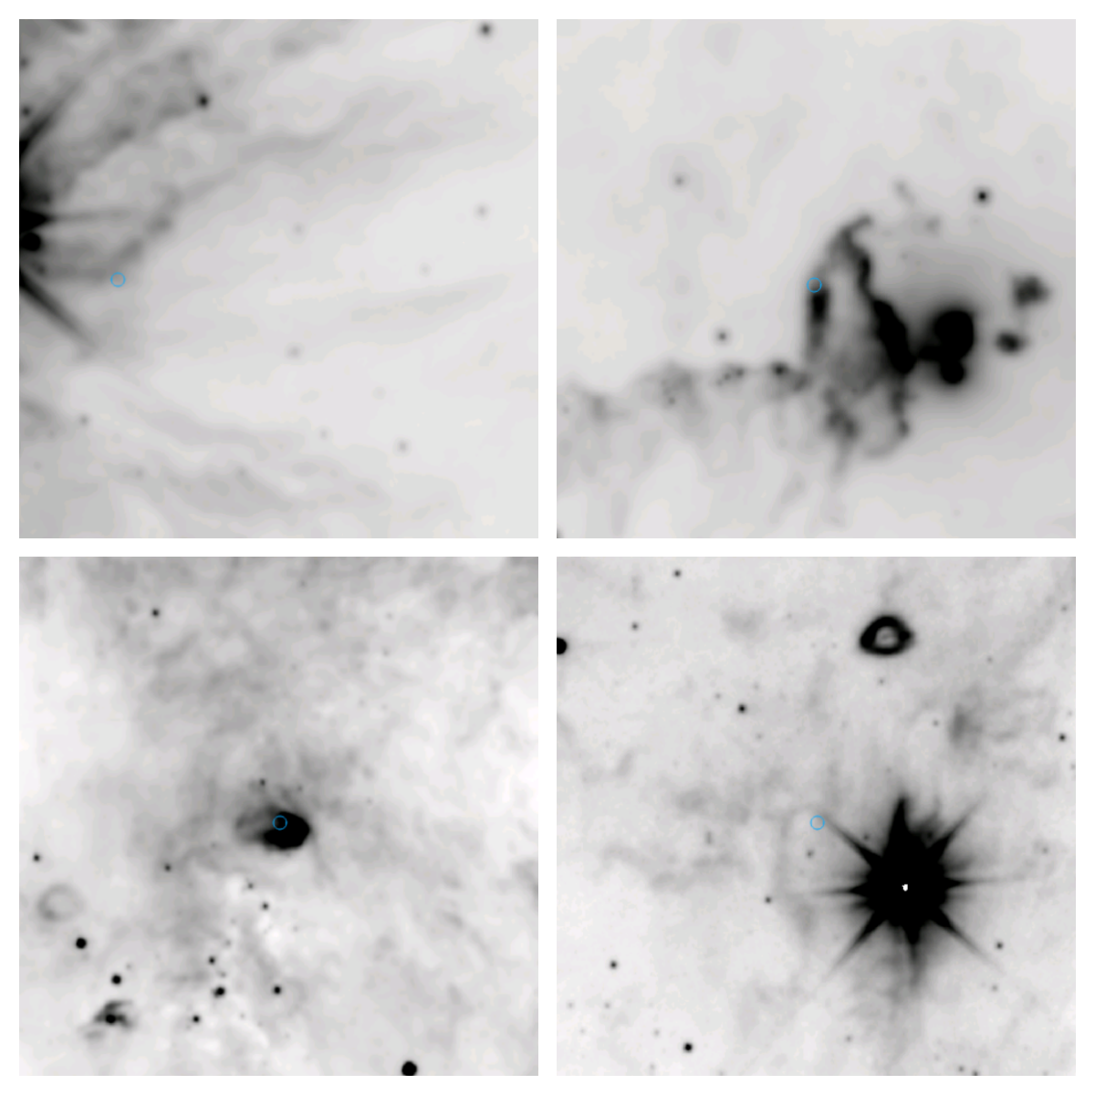
Prospective HII Regions identified with pipeline, cross-verified with citizen science catalog

